Slide 1
Sheet 3
Microprocessors CMPS-201

Slide 2
Today we will learn:
Interrupts
Macros Vs Procedures

Slide 3
Question 1
What is the function of the following code?
MOV AH,02
MOV BH,00
MOV DL,20
MOV DH,10
INT 10H

Slide 4
Solution 1
You should have an “interrupt cheat sheet” with you at all times when programming in assembly.

Slide 5
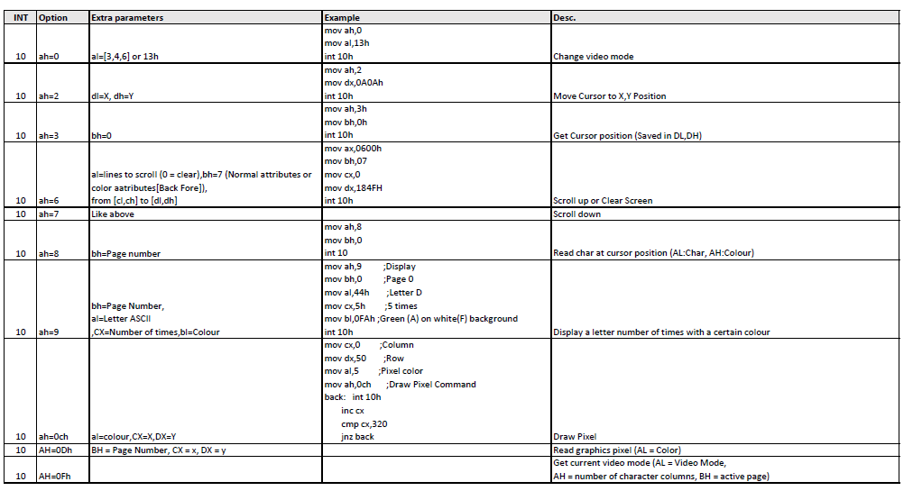

Slide 6
Solution 1
MOV AH,02
MOV BH,00
MOV DL,20
MOV DH,10
INT 10H
This moves the cursor to X location (20) and Y location (10) Remember: in text mode, the screen is 80 x 25 chars.

Slide 7
Question 2
Write the following macros:
MACRO DisplayString STR
MACRO ReadString PROMPT
MACRO DisplayNumber ; (Displays the number stored in AX)
MACRO ReadNumber ; (Read a number from user. Store it in AX)

Slide 8
Macro Vs proc
A macro is a way of telling the assembler to copy and paste a block of code somewhere.
We are all about clean code and readability.
A procedure on the other hand, is fundamentally different.
When you call a procedure, you push the address of the next instruction on the stack. When returning, you pop the address into the instruction pointer registers.
Pushing and popping takes time.

Slide 9
Background info
If we have a low number of instructions, and by low we mean that these instructions take less time than CALL and RET :
Then using a procedure would slow down our program.
Using a macro could be better. Check the context.
If we have a large number of instructions such that copying and pasting them multiple times would take too much space in the code segment:
Then using a procedure is recommended.
A macro would increase the program size.

Slide 10
Macro vs Proc
proc_name proc
dummy_instruction_1
dummy_instruction_2
ret
endp proc_name
call proc_name
DisplayString MACRO string_offset
mov ah, 9 ; Select option for int 21; ah = 9 means display string.
lea dx, string_offset ; String offset needs to be in dx.
int 21h ; Call the interrupt.
ENDM

Slide 11
Question 2 A
Required: Make a macro that displays a string stored in memory.
DisplayString MACRO string_offset
mov ah, 9 ; Select option for int 21; ah = 9 means display string.
lea dx, string_offset ; String offset needs to be in dx.
int 21h ; Call the interrupt.
ENDM

Slide 12
Question 2 B
Required: Make a macro that takes a string from the keyboard and stores it in memory
ReadString MACRO prompt_offset, string_offset
DisplayString prompt_offset ; Display the prompt.
mov ah, 0ah ; Select an option for interrupt 21h
; ah = 0a means read from keyboard.
lea dx, string_offset ; Result offset must be in dx.
int 21h ; Call the interrupt
ENDM

Slide 13
Using MACROS
.data
prompt db "Enter any text: ", 0ah, '$'
user_input db 15, ? , 15 dup('$')
u_typed db "You Typed: ", 0ah, '$'
.code
main proc far
mov ax, @data
mov ds, ax
ReadString prompt, user_input
DisplayString u_typed
DisplayString user_input+2
mov ah, 4ch
int 21h
main endp
end main
Why +2 ? When reading a string from the keyboard two control characters are inserted. We skip these to find the real text.

Slide 14
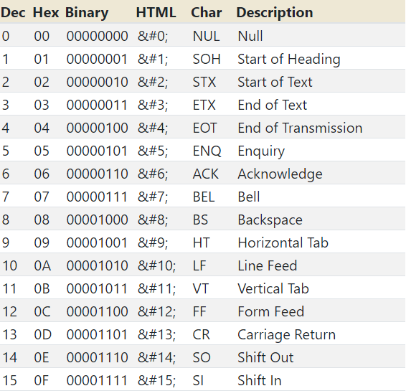
Question 2 C
We are required to display a number in the AX register.
The problem is AX contains numbers. We can only display characters.
There must be a way to convert each digit of AX into a character.
Each digit in AX is a number from 0 to 15 (Hex F)
These are the ASCII codes from 0 to 15

Slide 15
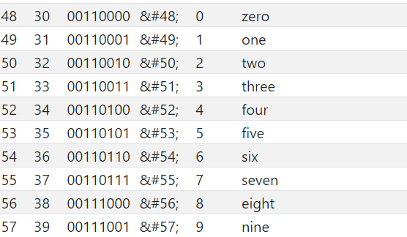
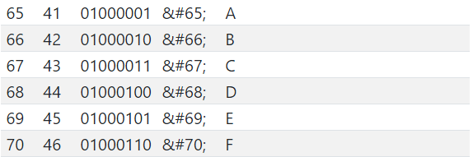
Question 2 C
Adding 48 (ASCII 0) to a number converts it into it’s corresponding character.
These are the ASCII codes that we should be printing. Notice the gap between the numbers 9 and 10 (Hex 0Ah)
We need to convert 10 to A, 11 to B and so on.
If we have the number 10 (0Ah) add 55 to it to get 65 (ASCII for ‘A’)

Slide 16
The plan
Process one hexadecimal digit at a time.
If AX is 012ABh then we process 1, 2, A, and B in separate loop iterations.
For each digit:
If it’s less that 10 (0Ah) Then it is a decimal number.
Add the offset that converts it into its corresponding character.
If it’s equal to 10 (0Ah) or greater then this is a hex number.
Add the offset that converts it into the corresponding character.
After adding the offset, Print the character.

Slide 17
Step 0: Macro definition
The assembler “expands” the macro by copying and pasting.
If we use the DisplayNumber macro twice in our code, we would have multiple labels with the same name.
This is an error.
Solution: use the LOCAL keyword. This gives each label in the macro a name unique to its expansion
DisplayNumber MACRO
LOCAL LABEL_1
LOCAL Dummy_label_2
LABEL_1:
dummy_instruction_1
Dummy_label_2:
dummy_instruction_2
ENDM

Slide 18
Step 1: digit selection
We cant keep holding the number in AX since we will be using this register for interrupts.
No problem. Move AX to BX.
We will change multiple registers in this macro.
Push them all.
Just before finishing, pop them all.

Slide 19
Digit selection: bit masks
Bit masking is a method to select a subset of bits from a larger set of bits
Lets select the first digit of the register AH
AH | (0B5h) | 1 | 0 | 1 | 1 | 0 | 1 | 0 | 1
BH | (0Fh) | 0 | 0 | 0 | 0 | 1 | 1 | 1 | 1
AND AH, BH | (05h) | 0 | 0 | 0 | 0 | 0 | 1 | 0 | 1

Slide 20
Note
If AX = 01234h
We need to print the 1, then 2, then 3, and finally the 4.
This means we have to print from left (most significant 4 bits of AH) all the way to the right (the least significant 4 bits of AL)
1234

Slide 21
Printing
To print a character, we use INT 21H with AH = 2. The character to print should be stored in DL.

Slide 22
Code: Init
DisplayNumber MACRO
LOCAL digit_select
LOCAL dont_shift
LOCAL convert_hex
LOCAL convert_decimal
; We know 16 bits are 4 hex digits.
; we loop on the contents of ax and display each digit on its own.
pusha ; We will change all registers.
; Save them to retrieve them later.
; Good etiquette. Not available in
; the 8086. use the 80286 instead.
mov cx, 0 ; Loop counter
mov bx, ax ; We use ax for interrupts.
; Keep our number in bx for now.

Slide 23
Code: digit selection
digit_select:
cmp cx, 0
je dont_shift
shl bx, 4
dont_shift:
mov dx, bx
and dx, 0f000h ; Bit mask to select the last digit only
; Now, our character is the in the MSB of
; DX.
shr dx, THREE_HEX_DIGITS_IN_BITS ;This puts the number in the LSB of dl.
To define a constant:
THREE_HEX_DIGITS_IN_BITS EQU 12

Slide 24
Code: number → ASCII
cmp dl, 10 ; Is the digit 10 or greater (hex A)?
jge convert_hex ; If yes, convert into the corresponding letter.
; If no, convert into the corresponding decimal number.
convert_decimal: add dl, '0' ; This is the character we want to print.
jmp print
convert_hex: add dl, 55 ; Difference between ASCII character 'A' and ASCII number 10.
; ASCII (Letter A) = 65
; ASCII 10, well, is 10.
; 65 - 10 = 55. Math.

Slide 25
Code: printing
print:
mov ah, 2
int 21h
inc cx
cmp cl, 4
jne digit_select
popa
ENDM

Slide 26
Question 2 D
We need to read a number from keyboard, and store this number into the AX register.
This is the reverse of the last problem. We take as input a bunch of bytes in ASCII and we need to convert each byte into a number and put that number into the AX register.

Slide 27
The plan
To take an input from the user, we can use the MACRO we made earlier, ReadString.
The buffer size has to be 5. Four digits and the newline character.
We convert each byte into its numerical equivalent (ASCII → number)
Place each digit in its place in the AX register.

Slide 28
ReadNumber MACRO
ReadString prompt, user_input_num
mov bx, word ptr [user_input_num+2] ; Lower part of the number
mov ax, word ptr [user_input_num+4] ; Higher part of the number
; Convert all ASCII to numbers
ConvertAsciiToHex ah
ConvertAsciiToHex al
ConvertAsciiToHex bh
ConvertAsciiToHex bl
ENDM
word ptr [user_input_num]
word ptr [user_input_num+2]
word ptr [user_input_num+4]
Memory | ♣ | ♦ | 31h | 32h | 33 | 34h
Address | user_input_num | +1 | user_input_num+2 | +3 | user_input_num+4 | +5
♦♣
BX = 32 31
AX = 34 33

Slide 29
ConvertAsciiToHex MACRO reg8
LOCAL done
; This converts the byte in reg8
; into its hex equivalent.
sub reg8, '0'
; if its decimal then we are done
cmp reg8, 0ah
jl done
; If not, then it is in hex
sub reg8, 7
done:
ENDM

Slide 30
ReadNumber MACRO
ReadString prompt, user_input_num
mov bx, word ptr [user_input_num+2] ; Lower part of the number
mov ax, word ptr [user_input_num+4] ; Higher part of the number
; Convert all ASCII to numbers
ConvertAsciiToHex ah
ConvertAsciiToHex al
ConvertAsciiToHex bh
ConvertAsciiToHex bl
shl al, 4
or al, ah
shl bl, 4
or bl, bh
mov ah, bl
ENDM
Remember:
4 bits is one hex digit
Shifting by four bits moves the whole number by a digit
Logical Shift Left (0Ah, 4) = (0A0h)
BX = 02 01
AX = 04 03

Slide 31
Any questions?
“There are no foolish questions and no man becomes a fool until he has stopped asking questions.” – Charles Proteus Steinmetz

Slide 32
Lab Requirements
Solve Points C and H from question 4.

Slide 33
Thank you.

